Slide 1
Student Seminar: Exploiting Two Factor Authentication of Android and IOS
Robin Solignac
235020

Slide 2
1. Introduction: The 2 Factors Authentication Model

Slide 3
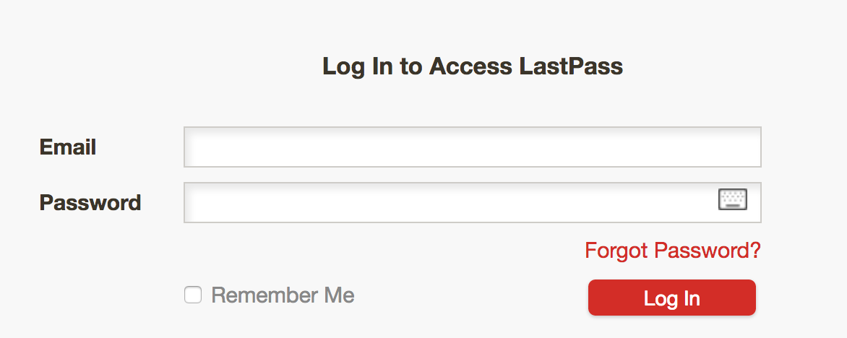
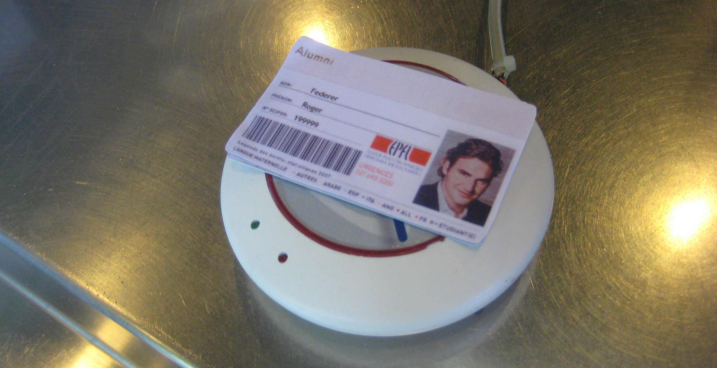
1. Presentation of 2FA model The concept
Combination of 2 access control in order to authenticate
Something you know + Something you have
Main goal: prevent authentication by third party in case of compromised password or main communication channel

Slide 4
1. Presentation of 2FA model The choice of smartphones
Majority of online modern 2FA use (smart)phone as “something you have”
Convenient: Don’t require the user to carry yet another card or devices
Available: Large majority of user have one
Reachable & Out of band: services can send message to it without using the main communication channel
Implement by Google, Microsoft, Amazon, Twitch, Twitter, Visa, Lastpass, …

Slide 5
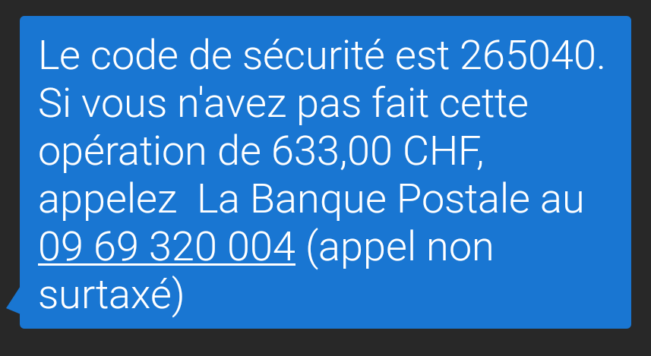
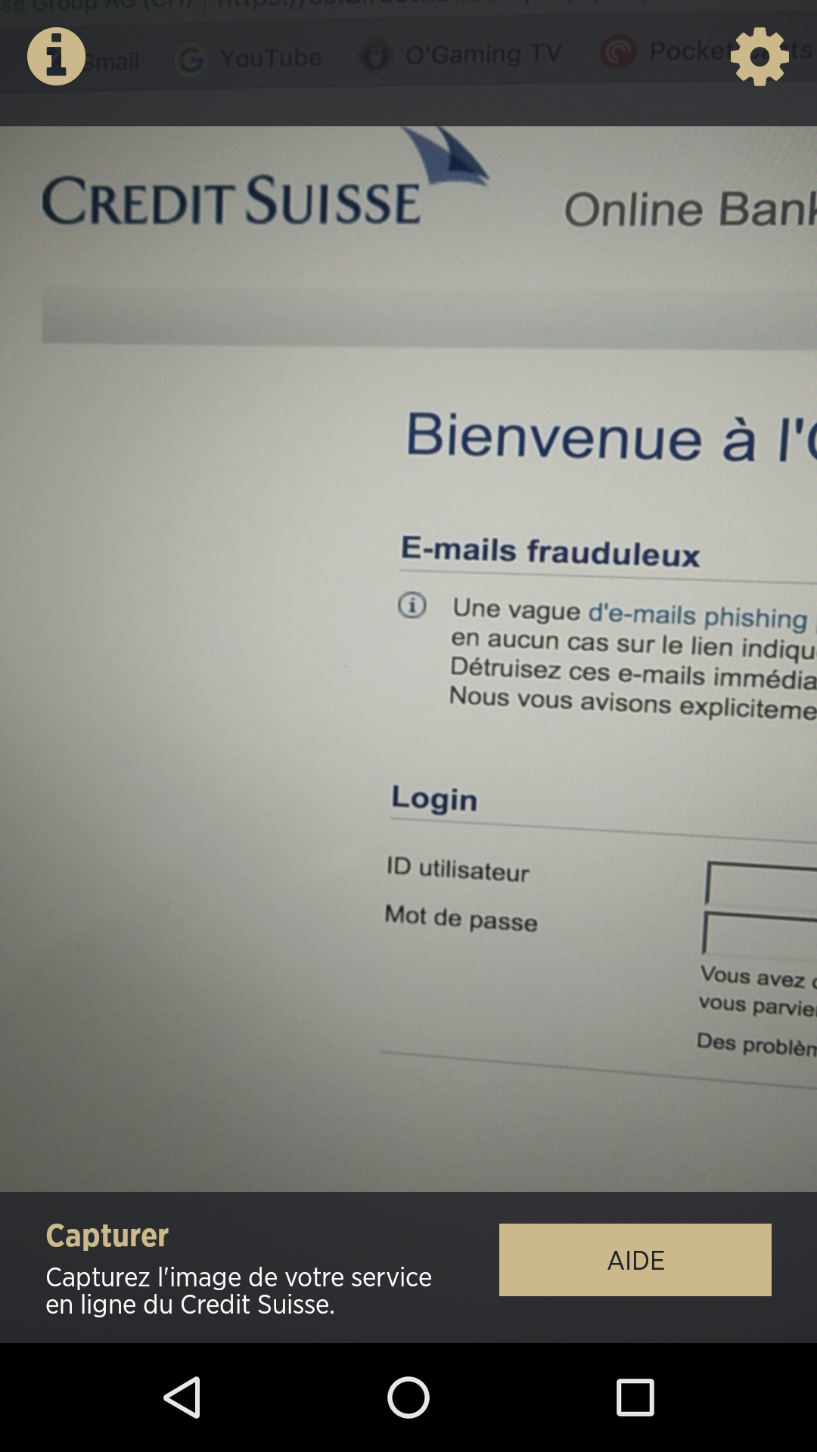
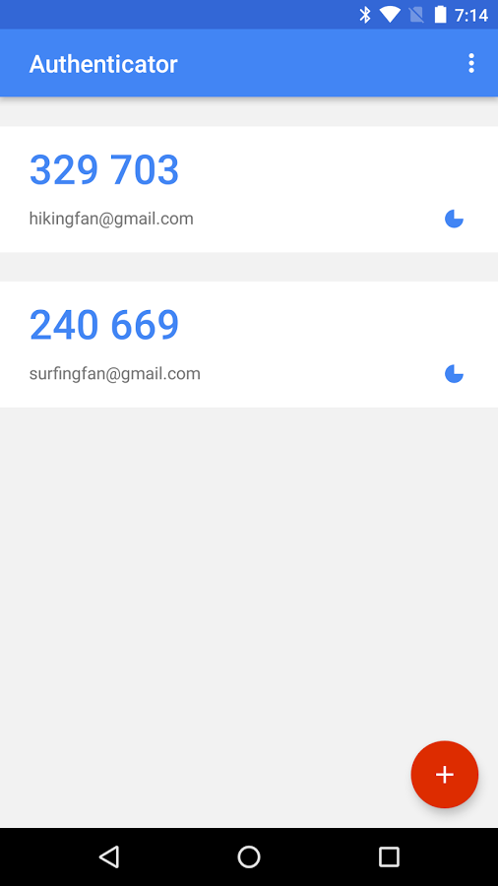
1. Presentation of 2FA model Smartphone 2FA implementation
SMS One Time Password (OTP)
Dedicated application
Can rely on OTP or not

Slide 6
1. Presentation of 2FA model SMS 2FA scheme
User try to authenticate on PC with password
If succeeds, service send SMS containing OTP to user’s phone
User enter OTP on PC
If correct, user successfully authenticate

Slide 7
1. Presentation of 2FA model Today’s goal
2FA made to prevent authentication if only PC compromised
Goal: try to pass 2FA with only a compromise PC

Slide 8
2. Key concepts

Slide 9
2. Key concepts Synchronization
Actions performed one devices will have impact on the other
Make use of the 2 smoother
Purposely implements by developers
Blur the line (Air-gap) between the two

Slide 10
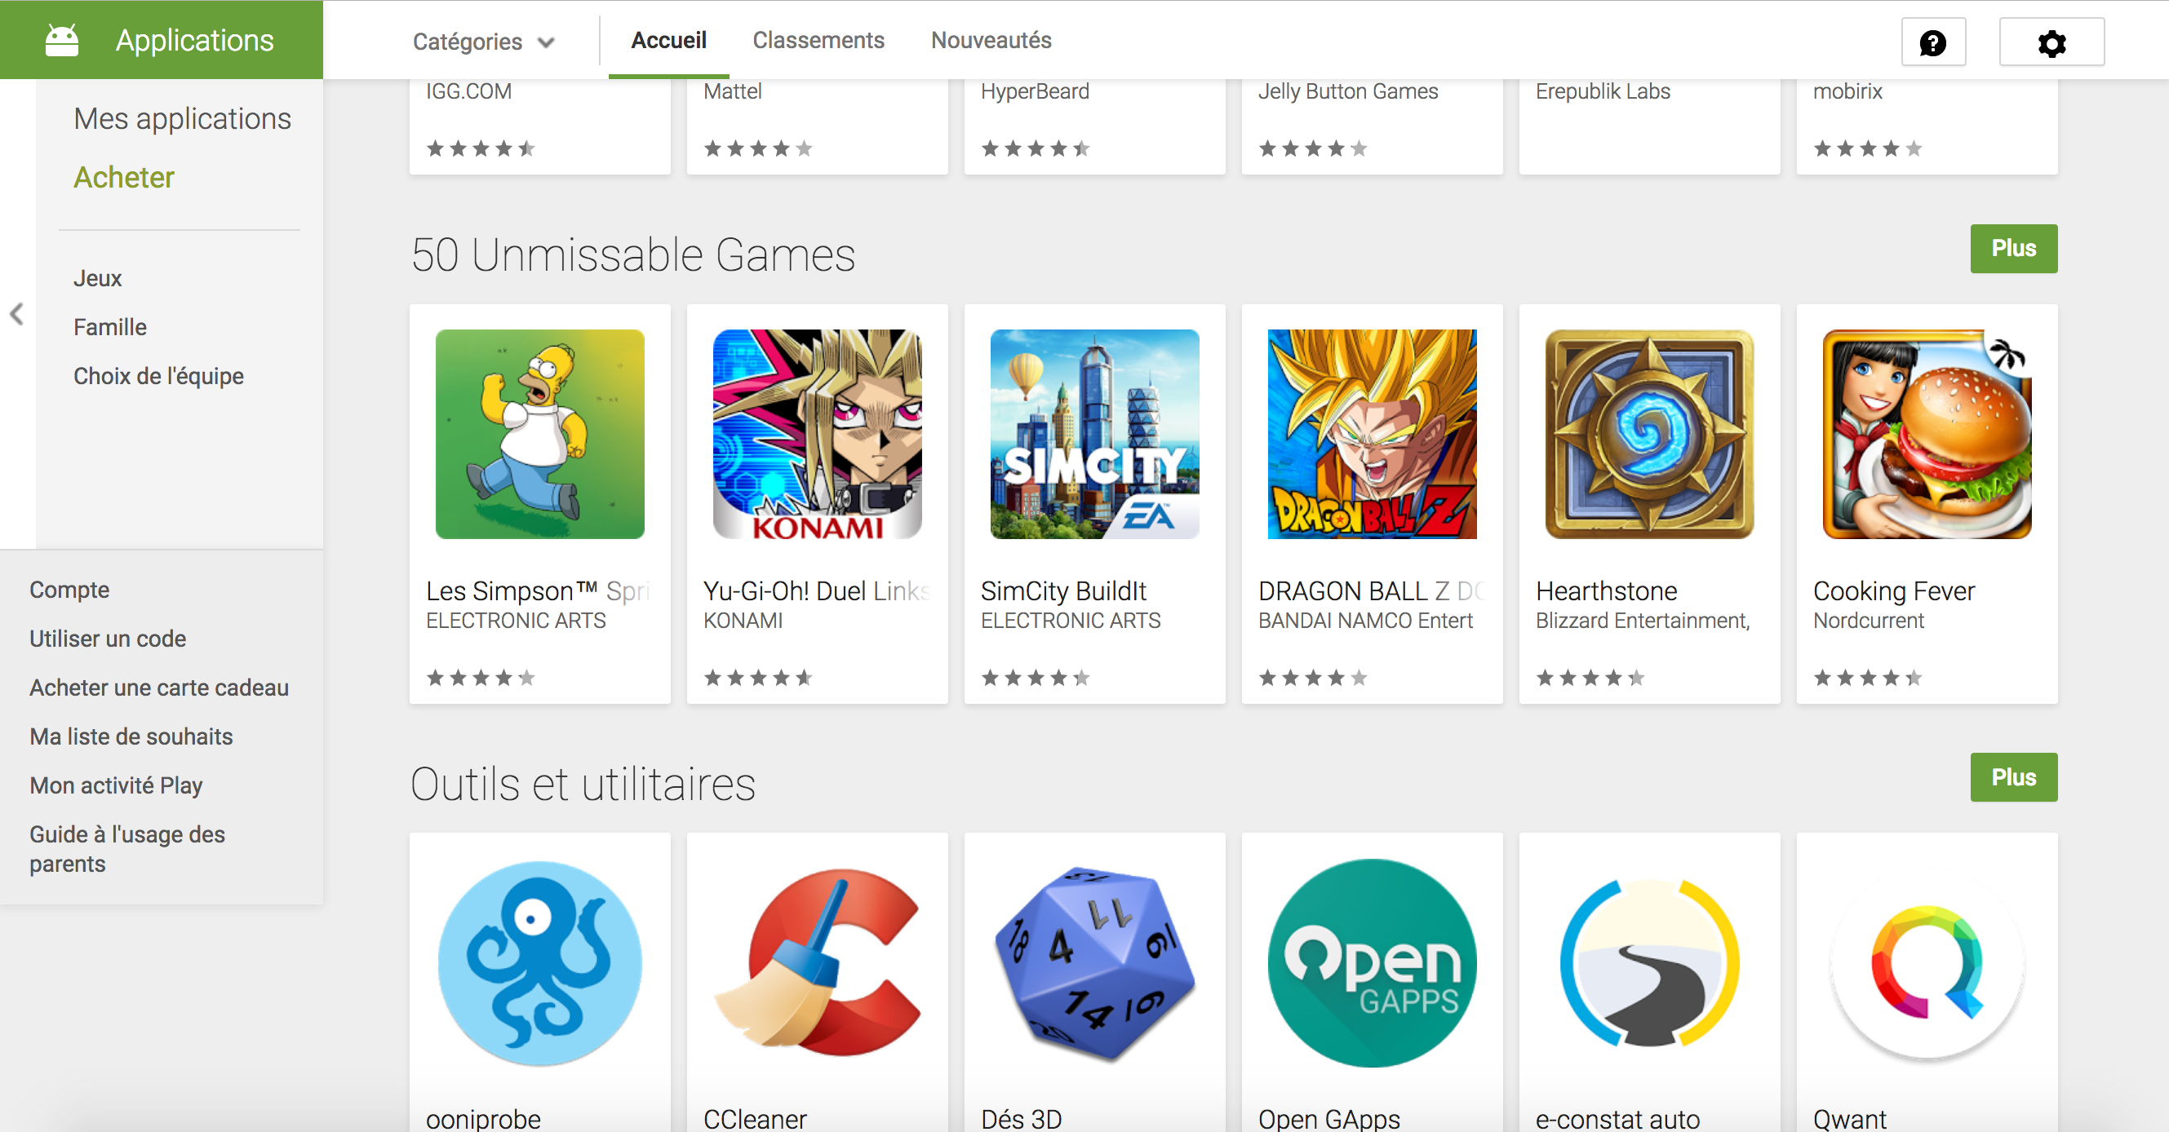
2. Key concepts Synchronization: Google play store website
Possibility to install, from the browser, applications on the phone
Need to be logged under the same Google account
Authorization also confirmed from the browser

Slide 11
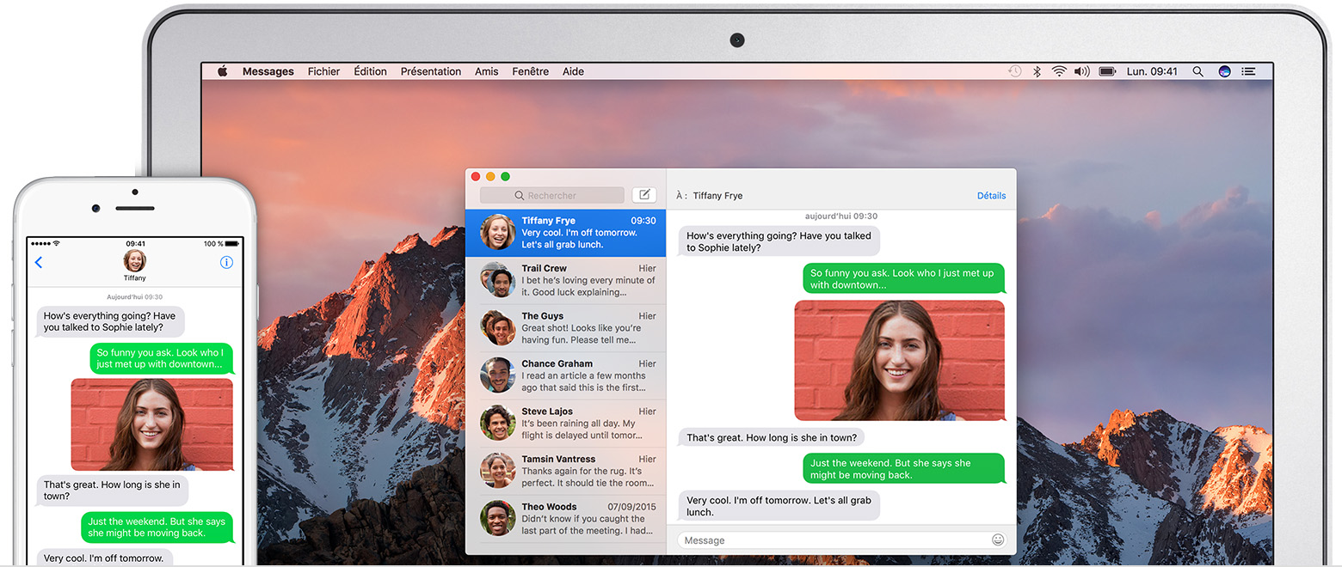
2. Key concepts Synchronization: Apple Continuity
If user posses an IPhone and a Mac, ability to send and read SMS and IMessages from the mac.
Message stored in clear on the mac
Off by default
Need to be on the same LAN

Slide 12

2. Key concepts Synchronization: Browser Sync
Synchronization of Bookmarks, history and open tabs between devices
Available on majority of popular browser
Sync if logged under the same user account

Slide 13
2. Key concepts MitB: Man in the browser attack
Stronger Variant of Man in Middle attack. the attacker can do everything a browser can.
Like man in the middle:
Read and modify all data exchanged
Send arbitrary data in the name of the user
Unlike man in the middle:
Read and modify encrypted data before encryption & after decryption
Read and modify browser related information: settings, cookies, bookmarks, history.

Slide 14
3. 2FA Attacks

Slide 15
3. 2FA Attacks The model
The PC is compromised (physically stolen, Malware, malicious plugin, …)
MitB attack is performed
Connection to the service is hijacked (via password or cookie)
To complete authentication (or transaction) OTP\TAN is send via SMS to victim phone
Phone is sane and run either on Android or iOS
Goal: steal the SMS

Slide 16
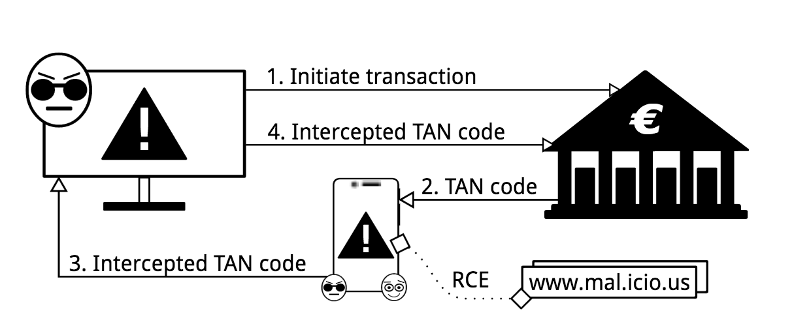
3. 2FA Attacks Android
Form MitB hijack Google session
Remotely Install SMS stealing app from playstore
App will forward OTP or TAN to attacker
2 difficulties:
Bypass Google Bouncer
Activate the App

Slide 17
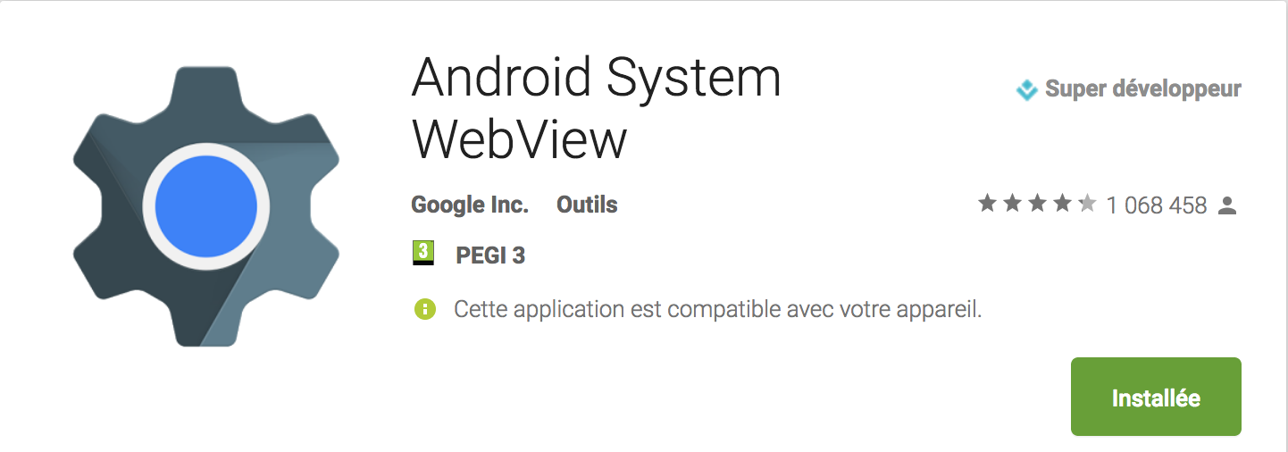
3. 2FA Attacks Android | Google Bouncer
Automated malware analysis tool deployed on Playstore
Analyses all uploaded apps
Static and dynamic analysis
Recent work show its easy to bypass.
Example: execute malicious code remotely via web-view

Slide 18
3. 2FA Attacks Android | App activation
Apps can’t be triggered by an external event (i.e. SMS) until being opened for the 1st time
Need to trick user into opening it
Solution 1: clickbait title
Make user want to click on the notification

Slide 19
3. 2FA Attacks Android | App activation
Solution 2: Browser redirection activation
Webpages can trigger opening of apps (i.e. Twitter)
Modify all history, bookmarks and tabs to links who will trigger the app
This is consider as a valid first opening
Malicious app can then redirect to the original link
After activation:
rewrite all links back to normal
Hide the app
http:\\mal.icio.us\proxy.php?url=<original_url>

Slide 20
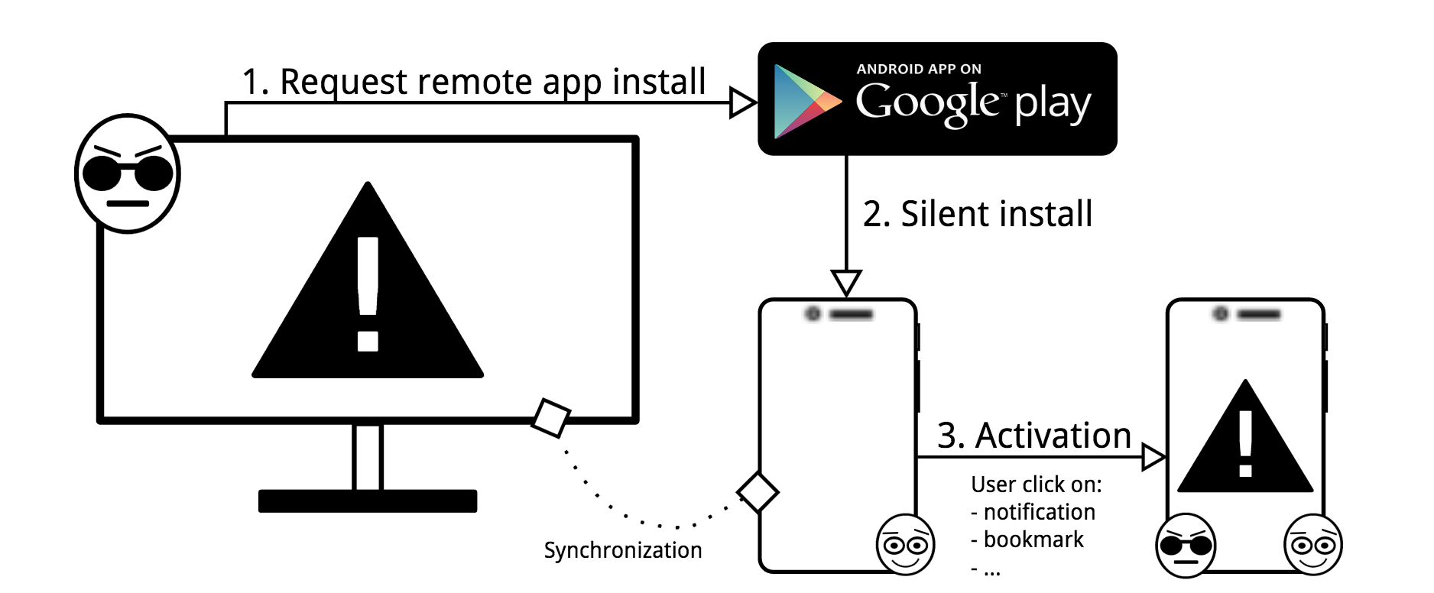
3. 2FA Attacks Android | Setup Summary

Slide 21
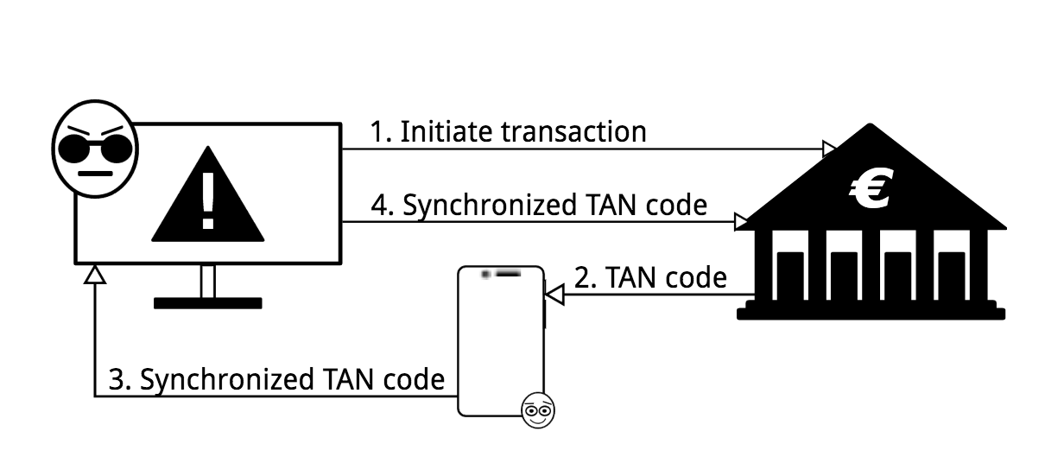
3. 2FA Attacks iOS
Since 2015 App can’t read SMS and notification
But if Continuity is activated:
All SMS are automatically send to the mac
Readable in clear by the browser

Slide 22
4. Discussion
Particularity, feasibility and solutions

Slide 23
4. Discussion An attack on assumption
After initial MitB infection, No use of bug or exploit, Only features offered by Google and Apple
Hearth of the problem:
Sync features reduce the air-gap
2FA assume the Air-Gap exist while designing the scheme
Result: System unsecure by flawed assumption
Hard to fix:
Either Modify (reduce) offered sync features
Or find New model on new set of assumption

Slide 24
4. Discussion Android | Feasibility
Highly feasible:
Google account extremely likely to exist & used on both devices
Google chrome very likely to be used on smartphone
Result: attack very likely to be possible & successful

Slide 25
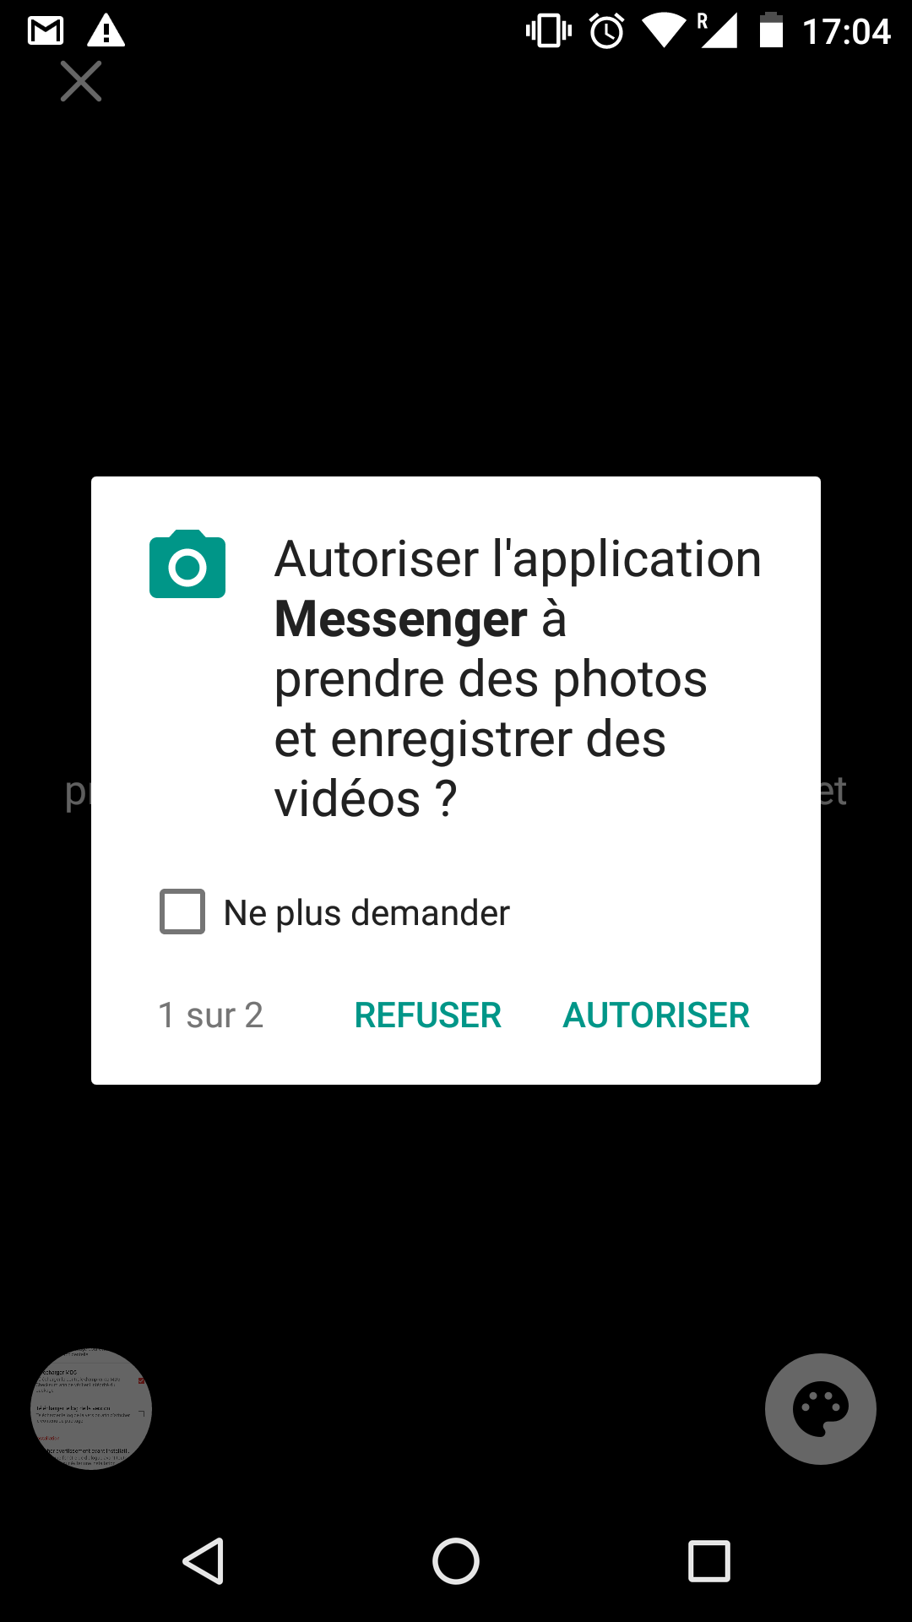
4. Discussion Android | Solutions
Already exist:
New authorization scheme since Marshmallow (October 2015)
Authorization confirmed at runtime by clicking on smartphone screen
Impossible to authorize remotely or from webpages
Problem:
App compiled for older version still used old scheme
Can be done purposely will still running on newer version
Likely to be not be possible in the future.
So attack still valid today but not in the (near ?) future

Slide 26
4. Discussion iOS | Feasibility
Need more prerequisite than android attack
Need to be a Mac
Off by default
Need to be on the same LAN
But If the first condition is fulfil, two others are very likely.
Reduce scalability more than feasibility

Slide 27
4. Discussion iOS | Solution
On Apple side: Sync only messages from number in contact list
Relative small impact on user experience
Seems to defeat the attack

Slide 28
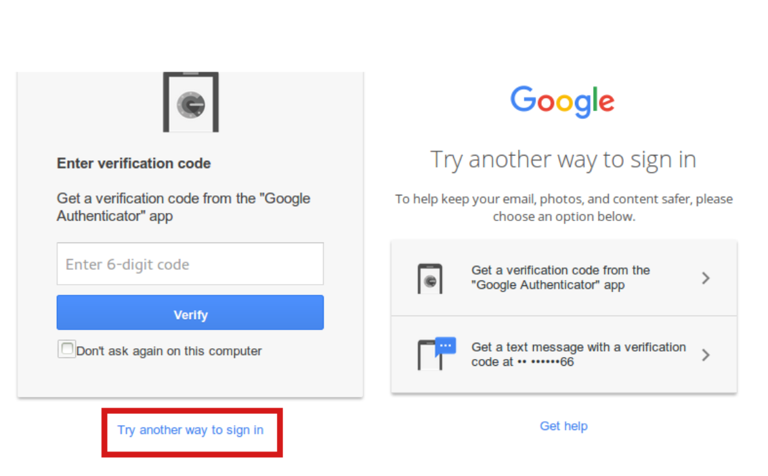
4. Discussion Other 2FA on smartphone
Most of services also propose dedicated app for 2FA
Sandboxing: App can’t access each other data
Theoretically defeat attacks
Problem: Most of services also propose SMS 2FA as backup solution
So attacks still work by asking to use backup solution

Slide 29
5. Conclusion

Slide 30
5. Conclusion
Souls of 2FA on smartphones: Air gap between smartphone and PC
Not true anymore for all channels used by smartphone
2FA implementation must choose wisely: Must be sure use channel is really out of band
SMS 2FA doesn’t seems to be secure anymore on iOS and Android

Slide 31
Images used
Epfl website: http://camipro.epfl.ch/paiement
Google Authenticator presentation on playstore : https://play.google.com/store/apps/details?id=com.google.android.apps.authenticator2
Apple website : https://support.apple.com/fr-ch/HT204681
Konoth et al. paper : http://fc16.ifca.ai/preproceedings/24_Konoth.pdf
Personal screenshots

